Slide 1
7111-AI-Driven Exploration and Prediction of Company Registration Trends with Registrar of Companies (RoC)
—V.MAHIBA (711121106048)

Slide 2
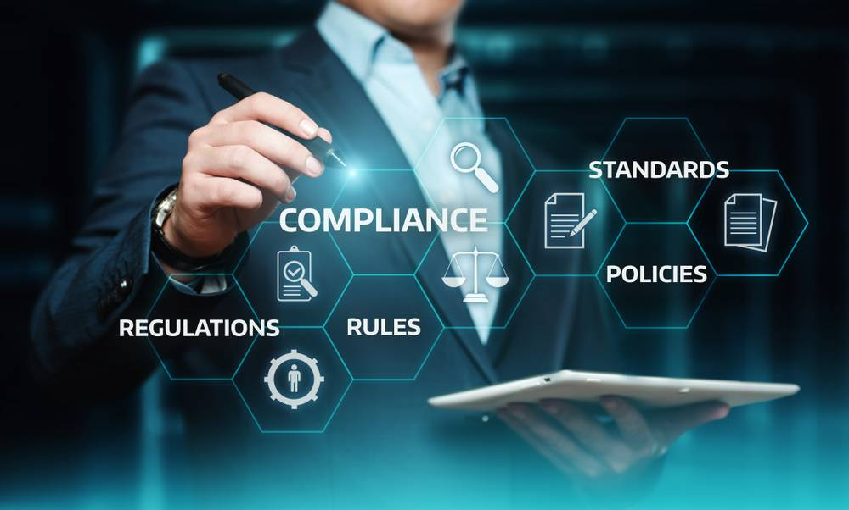
OBJECTIVE:
The primary aim of this project is to leverage artificial intelligence (AI) and data from the Registrar of Companies (RoC) to explore historical company registration trends and make predictions about future trends.

Slide 3

DESIGN THINKING
INTRODUCTION:
The Registrar of Companies (RoC) is a government agency in India that is responsible for registering and regulating companies.
The RoC maintains a database of all registered companies, which includes info rmation on the company’s name, date of incorporation, address, and directors.
This database can be used to generate a variety of insights into company registration trends. For example, the RoC data can be used to track the number of new companies registered each year, the types of companies being registered, and the geographical distribution of new companies.

Slide 4
AI can be used to enhance the analysis of RoC data in a number of ways. For example, AI can be used to:
Identify patterns and trends in the data that would be difficult to spot manually. For example, AI can be used to identify industries that are seeing a surge in new company registrations, or regions that are attracting a lot of new businesses.
.

Slide 5
* **Automate the analysis of RoC data, which can save time and resources.**
For example, AI can be used to automatically generate reports on company registration trends, or to identify companies that are at risk of defaulting on their loans.
* **Make predictions about future company registration trends.**
For example, AI can be used to predict the number of new companies that will be registered in the next year, or the types of companies that will be most popular with new entrepreneurs

Slide 6
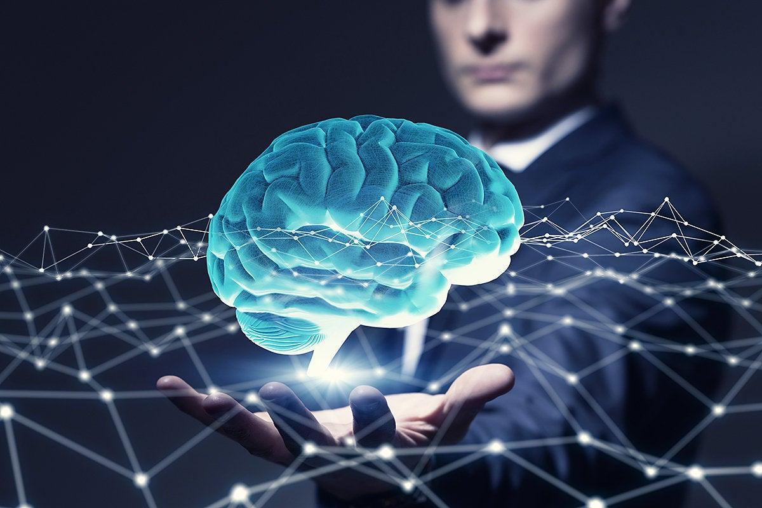
ASSUMING STEPS TO BE FOLLOWED

Slide 7
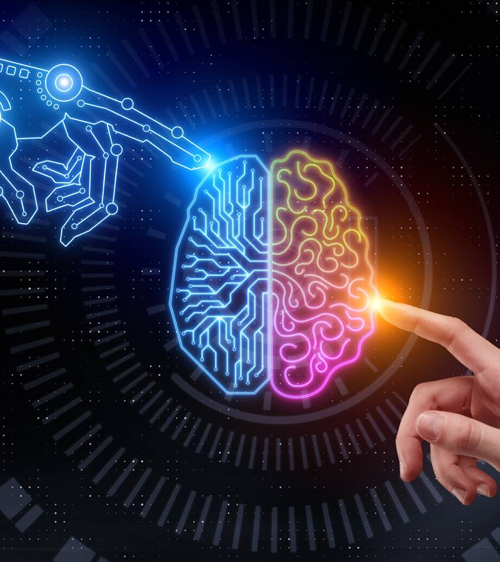
Data Collection:
Gathering comprehensive data from the Registrar of Companies (RoC) database.Ensuring data quality and integrity through preprocessing.

Slide 8
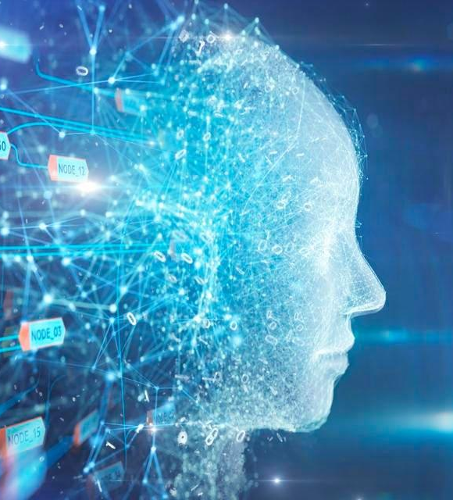
Data Exploration:
Analyzing historical registration data to identify patterns and trends.Generating visualizations to illustrate insights.
AI and Machine Learning:
Utilizing advanced AI and machine learning algorithms.Training models on historical data to understand registration patterns.

Slide 9
Prediction Models:
Developing predictive models to forecast company registration trends.Evaluating the accuracy and reliability of these predictions.
Business Applications:
Identifying practical applications of the project's findings.Highlighting how businesses, investors, and policymakers can benefit.

Slide 10

Significance:
Understanding company registration trends is crucial for economic analysis, investment decisions, and policymaking.AI-driven predictions can offer valuable insights for stakeholders in various industries.

Slide 11
Conclusion:
This project combines data analysis, AI, and domain knowledge to provide actionable insights into company registration trends. It has the potential to inform strategic decisions and contribute to a better understanding of the business landscape.

